Slide 1
VMware Updates Explained
+
Your Logo Here
A guide to help navigate recent changes to VMware’s product portfolio and licensing agreements.
Issued April 2024
What’s Inside:
Overview of Changes
New Core Offerings
Changes to Products
Changes to Support and Services
Impact on Cloud Service Providers
Migrating off VMware – Considerations and Opportunities
Resources

Slide 2
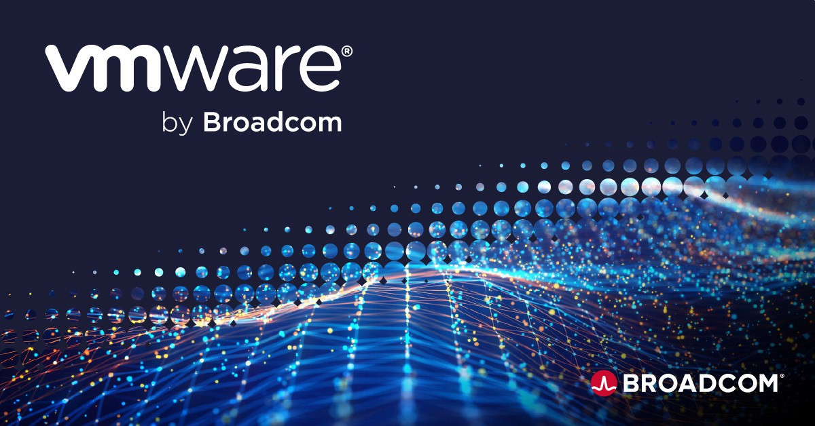
Overview of VMware’s Transition to Subscription-Based Models
In 2024, VMware announced significant changes to its product portfolio and licensing models related to Broadcom’s acquisition. The company has transitioned to a subscription model, introducing VMware Cloud Foundation (VCF) and VMware vSphere Foundation (VVF) as its core offerings. This shift means many VMware solutions will only be available as part of VCF or VVF, rather than as standalone products. Add-on services enhance these offerings covering storage, security, disaster recovery, and other specific needs.
Additionally, VMware is planning a "Bring Your Own License" option, allowing flexible deployment of subscriptions. This change aims to simplify the portfolio, enhance customer value, and accelerate innovation delivery. For those using products now at End of Availability (EOA), VMware will continue support until the end of existing subscription terms, after which customers will need to transition to the new models. The update includes a comprehensive list of products affected by these changes, indicating their replacement or integration within the new structure.

Slide 3
New Core Offerings and Changes
VMware's new core offerings, as part of their transition to a subscription-based model, are the VMware Cloud Foundation (VCF) and VMware vSphere Foundation (VVF). VCF is designed for customers seeking a full-stack infrastructure platform, integrating solutions like vSphere, vSAN, and NSX with the Aria management suite. On the other hand, VVF is tailored for data center optimization in traditional vSphere environments, including Tanzu Kubernetes Grid and Aria Operations as standard features. These offerings represent VMware's shift towards streamlined, subscription-only solutions, enhancing customer value and innovation delivery.
End of Availability (EOA) Products
VMware has announced EOA for several of its products, transitioning them to a more streamlined portfolio focused on VCF and VVF. This change means numerous standalone VMware products are now integrated into these core offerings or have been replaced by them. Notably, VMware vSphere Enterprise Plus, vSAN, and other key products are available within the VCF or VVF structure. This shift aims to simplify VMware's offerings and focus on subscription-based solutions, enhancing customer value and enabling a more straightforward approach to selecting VMware products.
End of Availability (EOA) items, effective May 6, 2024:
350M/750M/5G bandwidth tiers (for services SD-WAN, Enhanced Firewall Service, and Regional add-ons)
SD-WAN Software Orchestrator-Only deployment options
SD-WAN Work From Home subscriptions
VMware Edge Intelligence Hardware (Crawler and SFP)
Hardware Rental Program
Customer and Partner Success services (CPS)
Support:
VMware SASE Basic/Production/Premier support tiers
VMware SASE Carrier Grade Support
VMware SD-WAN Hardware Replacement Services

Slide 4
Purchasing & Licensing Offerings
Current Offering | Description | Replacement | Existing Subscription
Bandwidth Tiers 350M / 750M / 5G (for SD-WAN, Enhanced Firewall Service, regional add-ons, etc.) | VMware will reduce bandwidth licensing tiers from 12 tiers to 9 tiers. There are no price changes to remaining tiers. | The next lower or higher bandwidth tier. | Existing subscriptions will be honored, and service continued.
SD-WAN Software Orchestrator-Only Deployment Options | VMware will no longer offer Software Orchestrator-Only deployment options for Standard and Enterprise editions. | VMware will continue to offer Software Orchestrator + Software Gateway options for Standard, Enterprise, and Premium Edition. | Existing subscriptions will be honored, and service continued.
SD-WAN Work From Home Subscriptions | VMware Work From Home offers (WFH and WFH Pro) for remote workers will be discontinued. | Either the new SD-Access service or the regular SD-WAN per-site subscription. | Existing subscriptions will be honored, and service continued.
VMware Edge Intelligence Hardware (Crawler and SFP) | VMware Edge Intelligence will transition to a software-only solution. VMware will no longer offer the crawler hardware appliance and SFP hardware. | Virtual crawler for standalone-only deployments or SD-WAN Edge device for SD-WAN + Edge Intelligence deployments. | VMware will provide support for Crawler and SFP hardware for 5 years after the end of sale date for customers with an active VMware Edge Intelligence subscription.
Hardware Rental Program | Hardware Rental program will no longer be available directly through VMware. | Hardware will be available on a purchase basis. Rental options may be available from third-party providers. | Existing rental subscriptions will be honored. More information on an opt-in program for conversion of existing rentals to ownership will be provided in the coming weeks.

Slide 5
Customer and Partner Success (CPS)
VMware will no longer offer SASE Customer and Partner Success services (including Network Optimization Service, Enterprise Optimization Essentials Package, Health Check, Design Review, WAN Analysis Report, ROI - Outage Savings Report, Security Assessment, Dedicated Engineering Services, 8hr/1day/per week and 8hr x 5 days, On Prem Data Connection Setup Service, and Upgrade Benefit Analysis).
Existing entitlements will continue until completion. More information on Broadcom professional services will be provided in the coming weeks.
Support Programs
VMware SASE S1-Basic, S2-Production, and S3-Premier support tiers will no longer be available and will be replaced by Broadcom Essential Support. Moving forward, all SASE software/SaaS subscriptions will include Broadcom Essential Support.
Existing subscriptions will continue at the purchased support level.
Effective May 6, 2024, the response time for Broadcom Essential Severity 1 cases will be improved to 30 minutes, aligning with the current response times for Production and Premier tiers. For customers or service providers with support levels committed independently of price books/SKUs, these contracted support levels will be maintained. Customers/Partners in this category can contact their VMware account managers for further details.
VMware will no longer offer SASE Carrier Grade Support (CGS). Existing subscriptions to SASE Carrier Grade Support will be honored until their respective end of term. Broadcom Advanced Support will replace VMware SASE Carrier Grade Support as the alternative option. More details will be provided in the coming weeks.
VMware SD-WAN Hardware Replacement Services
Service (Current) | Replacement (Broadcommm)
Return to Replacement (RTR) Next Business Day Delivery 4-Hour 9x5 Delivery 4-Hour 24x7 Delivery Additional onsite option | VMware hardware replacement services will transition to Broadcom hardware support offerings: Broadcom Standard Standard Plus Advanced Premium Plus The onsite installation service will not be available on May 6, 2024, but may be considered as a future option. Hardware support, which is optional, will be available in various tiers. These new options will replace the current RTR included with hardware purchases.

Slide 6
Existing hardware warranty/replacement services will be honored until the end of term. Specific SKUs and pricing for the replacement offers indicated above will follow at a later date.
As VMware converts to the new Broadcom ordering system, the legacy VMware ordering system is planned to freeze at 5pm PST on April 24, 2024 (any order received after that date will need to be rebooked after May 6, 2024). All product shipments will end two days prior, on April 22, 2024. The sales team and partners must submit orders as early as possible to avoid de-booking and rebooking. After this transition period, the Broadcom ordering system will become the standard.
https://kb.vmware.com/s/article/96610
End of Availability (EOA) Support
VMware has outlined a support and transition plan. Customers currently using these EOA products do not need to take immediate action if they are not up for renewal. VMware will continue to offer active support throughout the duration of existing support contracts. At the time of renewal, customers can work with VMware representatives or partners to align their requirements with VMware’s updated portfolio, transitioning to the new offerings like VMware Cloud Foundation (VCF) or VMware vSphere Foundation (VVF) as appropriate.
“Bring Your Own License” Option
VMware's "Bring Your Own License" option is a new, flexible subscription model that allows customers to purchase VMware Cloud Foundation subscriptions from Broadcom. This model provides the flexibility to deploy these subscriptions across validated hybrid cloud endpoints as well as in their own on-premises data centers. This initiative is part of VMware's broader strategy to offer more adaptable and customer-centric solutions, accommodating various deployment needs and preferences within their evolving subscription-based framework.
Add-on Services
VMware’s add-on services, which complement their core offerings of VMware Cloud Foundation (VCF) and VMware vSphere Foundation (VVF), cater to a variety of specific customer needs. These services enhance the overall functionality and applicability of VMware's products in areas such as storage, security, disaster recovery, and Generative AI. By providing these add-ons, VMware aims to offer more tailored and comprehensive solutions to its users, ensuring that specific, niche requirements are met within its ecosystem of services.

Slide 7
Impact on Cloud Service Providers
The changes have led to tension within the VMware partner community, with reports of terminated reseller and cloud service provider agreements.
VMware’s cloud service provider program is being reduced from approx. 4500 service providers globally to approx. 400 on May 1, 2024. There will be two CSP tiers going forward:
Pinnacle – 100 globally 12 in the US
Premier – 400 globally, approx. 135 in the U.S.
Migrating off VMware: Considerations and Opportunities
If you are looking for an alternative:
Analysts estimate more than 80 percent of virtualized workloads and a large percentage of business-critical applications are running on VMware technology. However, many organizations are having an emotional and financial reaction to these changes and will be looking for alternatives to VMware. The most common options are Azure Stack, Citrix, and Nutanix but keep in mind there are many other solutions organizations can explore that suppliers are able to offer as an alternative.
Things to consider:
Maturity, ecosystem, tooling, and expertise. All these need to be accounted for when evaluating alternatives. There are a lot of hidden costs in people, timing, and capabilities.

Slide 8
Resources
Why Our Resources Are a Game-Changer for You
Comprehensive Coverage: Our resources provide an all-encompassing look at VMware’s latest changes - from subscription models to the new VMware Cloud Foundation (VCF) and VMware vSphere Foundation (VVF).
Expert Insights: Get insights from industry experts and thought leaders on what these changes mean for your business and how to leverage them effectively.
Actionable Strategies: We don’t just inform; we equip you with actionable strategies to turn these changes into opportunities for growth and innovation.
Conclusion
The changes at VMware have created confusion for existing VMware customers. This guidebook and our relationship with you is in place to help create a clear path forward and to increase your success and value to your own customers.

